Slide 1
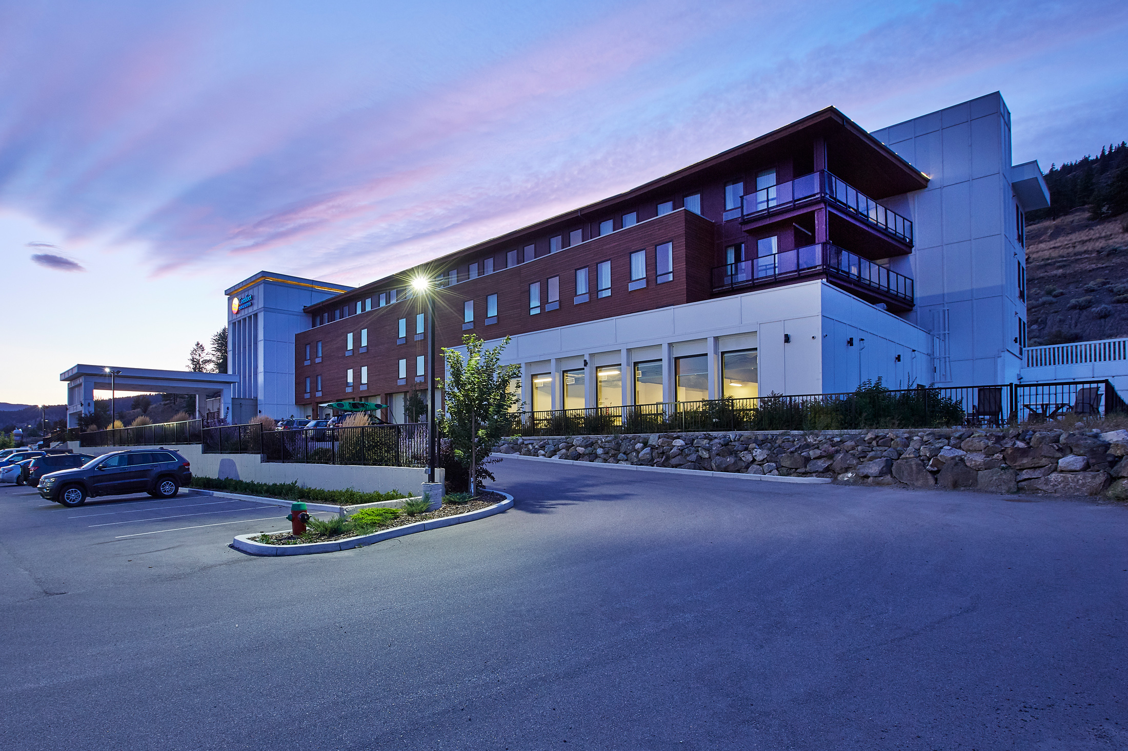
Audit Data Analysis on Hotel Booking
Presented by :- Nimesh Vadodariya
Guided by :- Abhishek wavhal , Professor

Slide 2

Overview or Summary of Project
This Project is upon Analysis of Hotel Booking.
The Overview of this project is Explore and analyze the data to Discover important factors that govern the bookings.
In this Project We are Analyzing ,Cleaning And Visualizing the data and Create a Dashboard of this data.
The Given Data is a Large amount of data so First of All We are Remove Errors, Duplicate Values and Cleaning Data.
After That We are Analyze the Data and Finding a Null Values and Data types error then Remove it.
Then We are Inserting a New Rows & Column and define a Primary key.
Then We are Visualizing a Data And Find a Solutions of the Data
At last We Are Create a Dashboard Using the Visualization of Chart

Slide 3
Define Business Objective ?
Analyse and visualize the data on bookings of City Hotel and Resort Hotel to gain insights on the different factors that affect the booking and ADR.
ADR: Average Daily Rate

Slide 4
Hotel - Type of hotel(Resort or City).
is_canceld - If there was booking cancel(0) or not(1).lead time - The number of days between time books their room to arrive hotel.
arrival_date_year - Year of arrival date.
arrival_date_month - Month of arrival date.
arrival_date_week_number - Week no. of year for arrival date.
stays_in_weekend_nights - No. of weekend nights(Saturday or sunday) spend by guest at hotel.
stays_in_week_nights -No. of weeknight( Mon to Fri) spend by guest at hotel.
adults - No. of adults among guest.
children - No. of children among guest.
babies - No. of babies among guest.meal - Type of meal booked by guest.
country - Country of guest.
market_segment - grouping into categories based on their booking patterns and travel habits.
distribution_channel - Name of booking distribution channel.
is_repeated_guest - If the booking was from repeated by guest(1) or not(0).
previous_cancelletions - No. of previous booking that were cancelled by the customer prior to the customer booking.
previous_booking_not_canceled - No. of previous booking that were not cancelled by the customer prior to the customer booking.
reserved_room_type - Code of room type reserved.
assigned_room_type - code of room type reserved.
booking_changes - No. of changes made to the booking.
deposit_type - Type of the deposit made by the guest.
agent - Id of the agent who made the booking.
company - Id of the company that made the booking.
days_in_waiting_list - No. of days the booking on the waiting list.
customer_type - Type of customer, assuming one of four categories.
adr - (Average Daily Rate) dividing the sum of lodgging transaction by the total number of staying night.
required_car_parking_spaces - No. of car parking spaces required by the customer.
total_of_special_request - No. of special request made by the customer.
reservation_request - Reservation status
reservation_request_date - Date of last reservation status updated.
Information About The Data (Column Discription)

Slide 5
Problem Statement :-
This data set contains booking information for a city hotel and a resort hotel, and includes information such as when the booking was made, the number of adults, children,and/or babies, and the number of available parking spaces, which agent made the booking , among other things.
The objective of this project is Explore and analyze the data to Discover important factors that govern the bookings.

Slide 6
TABLE OF CONTENTS
01
Extract
02
Transform
04
Load
03
Cleaning
05
06
Result
Chart

Slide 7
1.Data Extract:
First I checked that the data is in which form like, Excel,Csv,Sql…
Then i find the data is in Csv file.
Data from csv file taken in Power BI.
2. Transform:
Transform the collected data in to the Power Bi.

Slide 8
3.Cleaning:
After transform the data in Power Bi , i have done first process is change the data types where i need.
Second step which i follow is merged the date column using custom column and convert it to the date format.
Then remove null values and error in the hotel data.
Set A primary key as a guest Id in the Hotel data.
4.Load:
After completing all the processes of the cleaning, I loaded the data using close and Apply.

Slide 9
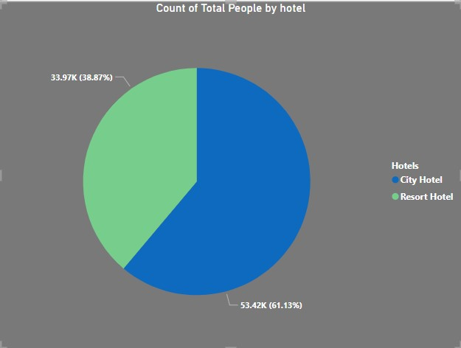
5.Chart:
I use Pie Chart because I find the Categorical data, City Hotel and Resort Hotel.
I Saw in this chart,People prefer to stay in city hotels more compare to result hotels.

Slide 10
6.Result:
The Result of Above Chart Mostly People Are Prefered a City Hotel.
Because of City Hotel Provided many types of Amenities compare to Resort hotel.
61.13% of people are like to stay in city hotel it means resort hotel has a develop and Provided Many types to facility to attract to the people.

Slide 11
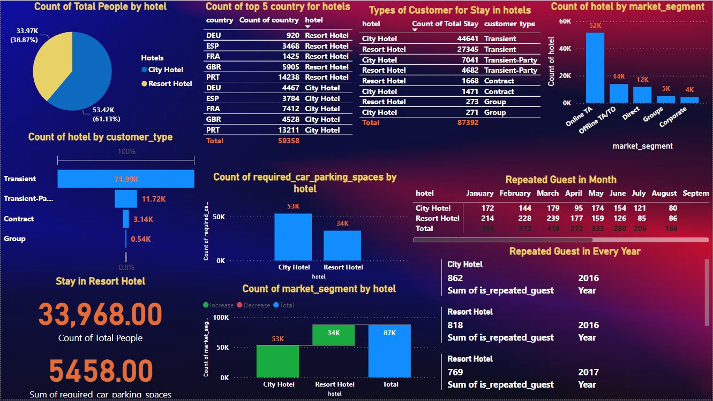

Slide 12
Question 1
I used the pie chart To check and understand the hotel type is resort or city in simple way of visualizing.
Based on the above observations, I found that 61.07% preferred city hotel and 38.93% preferred to book a resort hotel . Which means Resort hotels have less booking
Are there any insights that lead to negative growth? Justify with specific reason . City hotel can find more services to attract more guests to increase more revenue . Resort Hotel can find a solution to attract customers and also find the facilities provided by the city Hotel to attract customers . So Yes, gained insights help creating a positive business impact.

Slide 13
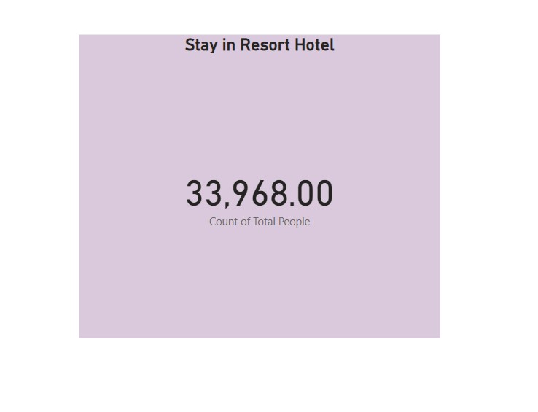
Question 2
I used the Card To check and understand the How many people is preferred Resort hotel for Stay .
Based on the above observations, I found that something “33,968” people preferred to book a Resort hotel. Which means City hotels have More booking
City hotel can find more services to attract more guests to increase more revenue . Resort Hotel can find a solution to attract customers and also find the facilities provided by the city Hotel to attract customers . So Yes, gained insights help creating a positive business impact.

Slide 14
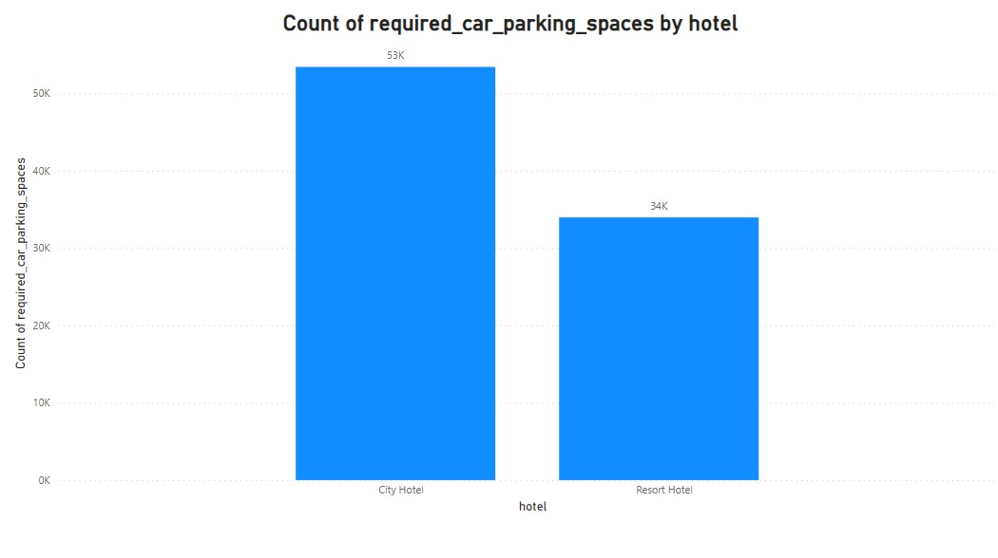
Question 3
I used the Column Chart To check and understand the How many Car Parking Space in the hotels.
Based on the above observations, I found that something Resort Hotel have not required car parking, but City Hotel have required more parking.
Resort hotel have Required less car parking . City Hotel can find a solution to attract customers and also give More car parking facilities provided by the city Hotel to attract customers . So Yes, gained insights help creating a positive business impact.

Slide 15
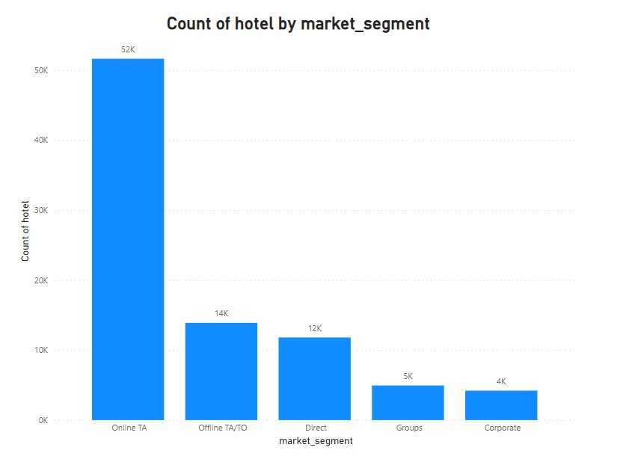
Question 4
I used the Column Chart To check and understand the people is preferred which platform is use for booking .
Based on the above observations, I found that 52,000 something people preferred to online booking , 14,000 something people preferred Offline(Agent)through booking and 12,000 something people preferred direct booking.
In this observation justify that things to Mostly people is preferred A online booking, and one and half present of people preferred a direct booking.so hotel can grow his revenue it can provided any facilities like coupon , lackey draw ,etc….

Slide 16
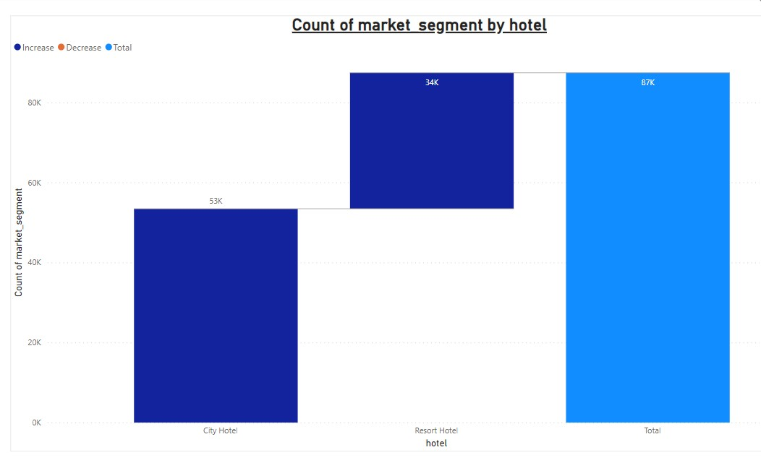
Question 5
I used the Waterfall Chart To check and understand the How many people is preferred Resort hotel for Stay .
Based on the above observations, I found that something “33,968” people preferred to book a Resort hotel. Which means City hotels have More booking
City hotel can find more services to attract more guests to increase more revenue . Resort Hotel can find a solution to attract customers and also find the facilities provided by the city Hotel to attract customers . So Yes, gained insights help creating a positive business impact.

Slide 17
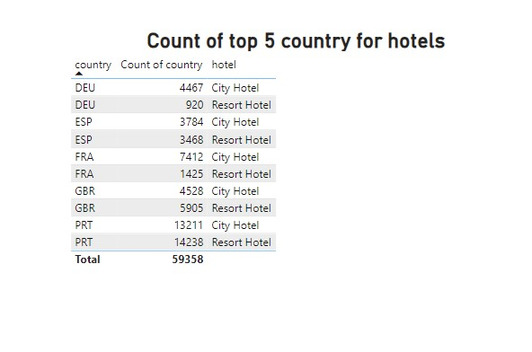
Question 6
I used the Table To check and understand Top 5 country’s How many maximum people is preferred for Stay in which hotel .
Based on the above observations, I found that to Portugal country’s “14,238” people preferred to book a Resort hotel. Which means The Resort Hotel is Demanding hotel in Portugal And in Germany only “920” people preferred to book a Resort hotel. Which means The Resort Hotel is less Demanding hotel in Germany .
In Portugal City hotel can find more services to attract more guests to increase more revenue . In Germany Resort Hotel can find a solution to attract customers and also find the facilities provided by the city Hotel to attract customers . So Yes, gained insights help creating a positive business impact.

Slide 18
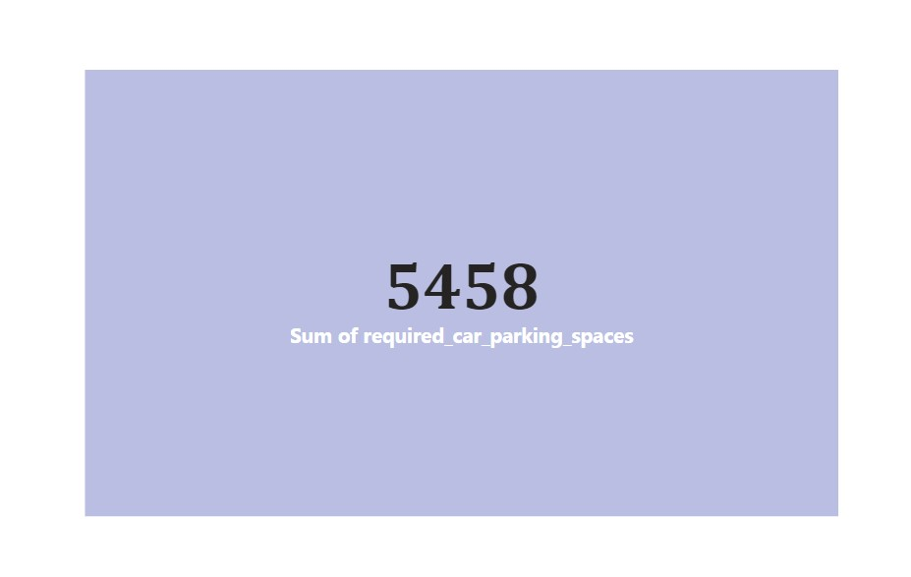
Question 7
I used the Card To check and understand the How much parking spaces is required in City Hotel.
Based on the above observations, I found that the only “5458” parking space is required for city hotel.
City hotel can find more services to attract more guests to increase more revenue . Resort Hotel can find a solution to attract customers and also find the facilities provided by the city Hotel to attract customers . So Yes, gained insights help creating a positive business impact.

Slide 19
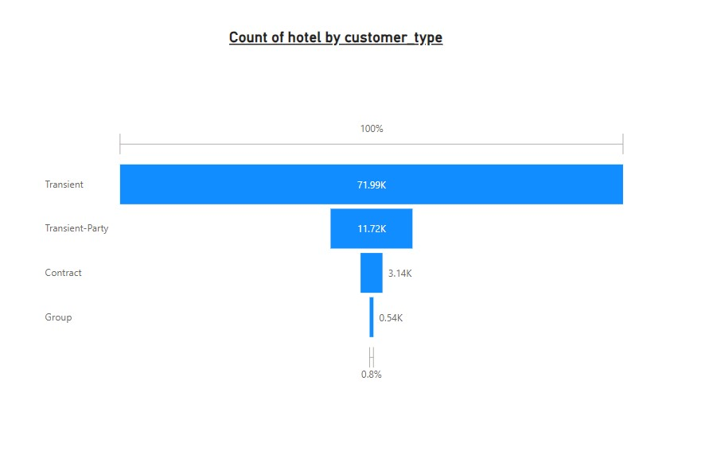
Question 8
I used the Funnel chart To check and understand the How many types of people is hotel for Stay .
Based on the above observations, I found that mostly the Transient peoples are used hotel, and group people are less booking.
City hotel can find more services to attract more guests to increase more revenue . Resort Hotel can find a solution to attract customers and also find the facilities provided by the city Hotel to attract customers . So Yes, gained insights help creating a positive business impact.

Slide 20
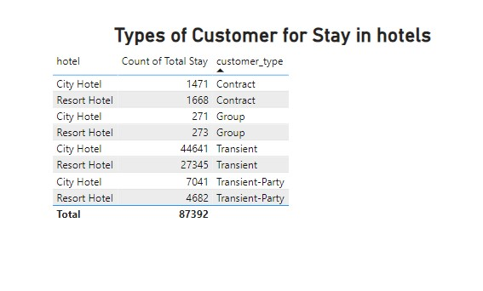
Question 9
I used the Table To check and understand the How many people is preferred Resort hotel for Stay .
Based on the above observations, I found that mostly the Transient peoples are preferred city hotel, and group people are less booking.
City hotel can find more services to attract more guests to increase more revenue . Resort Hotel can find a solution to attract customers and also find the facilities provided by the city Hotel to attract customers . So Yes, gained insights help creating a positive business impact.

Slide 21
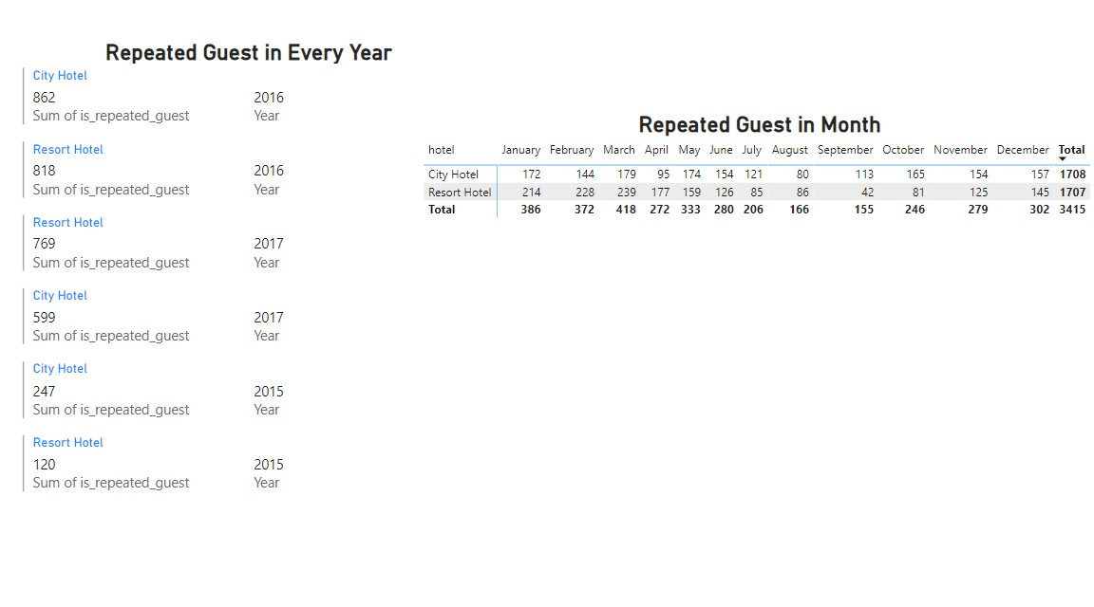
Question 10
I used the Matrix And Multi-Row Card To check and understand the How many peoples are visited hotels in year of 2015 to 2017.
Based on the above observations, I found that something in the Year of 2016 maximum peoples are visited the hotels. And Year of 2015 has a less peoples are visited.
City hotel can find more services to attract more guests to increase more revenue . Resort Hotel can find a solution to attract customers and also find the facilities provided by the city Hotel to attract customers . So Yes, gained insights help creating a positive business impact.

Slide 22
Solution to Business Objective
Solution of The Project if Resort Hotel Increase his Business then It has Develop More Facilities And Provided many Amenities to Attract to the people .
Amenities And Facilities like Parking facilities , Multi types of Dinner and Lunch Facilities , etc...
And Last And Most Important Thigs To Know About Customers Interesting Activities .

Slide 23
Conclusion
Conclusion Of the Whole Project 61.13% People Preferred A city hotel for stay because of multiple Reason.
And 38.87% people Preferred Resort Hotel because of lake of Facility and this hotel is far away from City so in holidays seasons customers this hotel.
If Resort Hotel improve his Amenities then Chance to increase his Business.

Slide 24

If You Have Any Query Regarding to the project then asked to me… -Nimesh Vadodariya

